Slide 1

File naming conventions
Pratice pits week 6.2

Slide 2
Definition
• Consistent way to name your files
• Easier to access and retrieve
• Makes files easier to find ( without opening)

Slide 3
The importance of file naming conventions
• Staying organized
• Predictability
• Clarity
• Identification

Slide 4
consequences of not using correct file naming conventions
Confusion and frustration
errors and inconsistencies
security and privacy risks
lost and corrupted files

Slide 5
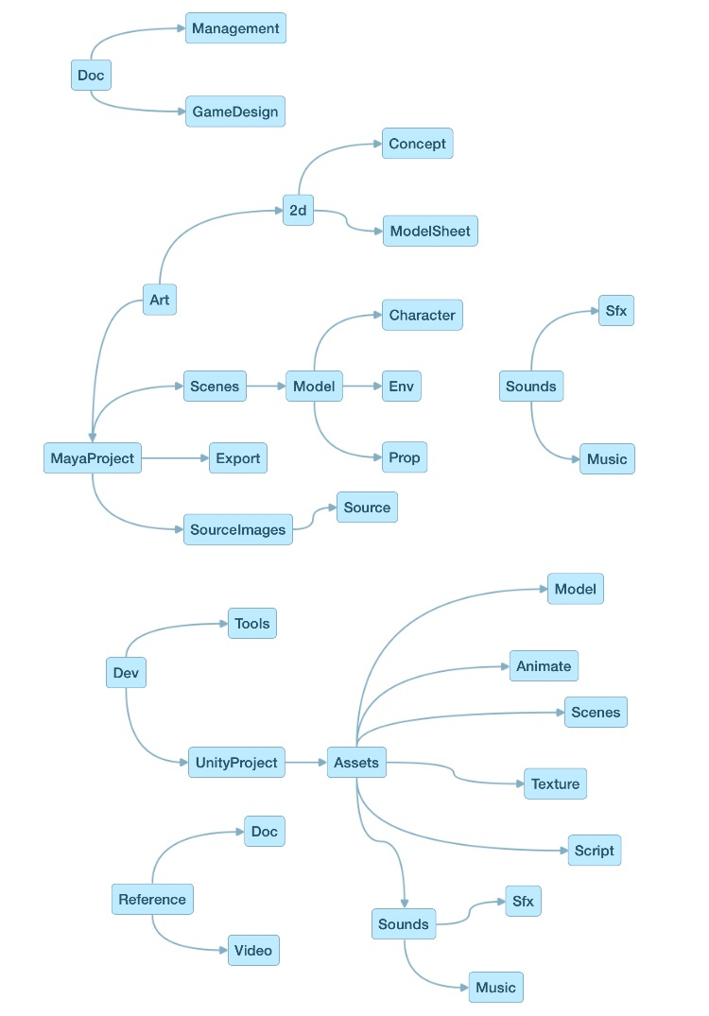
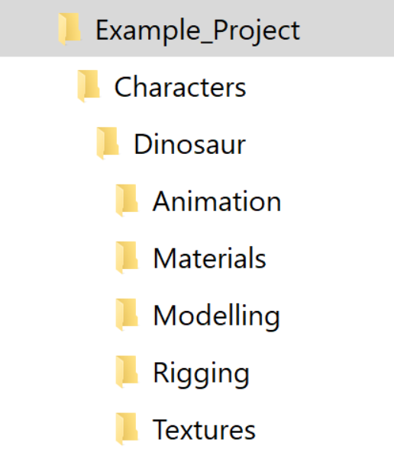
Examples

